Slide 1

Interest Groups
Hasan Muhammad Baniamin

Slide 2
Interest Groups
A group can be defined as an aggregation of individuals who interact in order to pursue a common interest
The factor that distinguishes a political interest group from other groups is that the common interest the group pursues is a political objective—an interest in a particular area of public policy where action might be taken.
The term interest group covers just about any collection of people trying to influence government.
Some focus on influencing a particular policy, others on broad changes. For example: Bangladesh Poribesh Andolon (BAPA) in Bangladesh

Slide 3
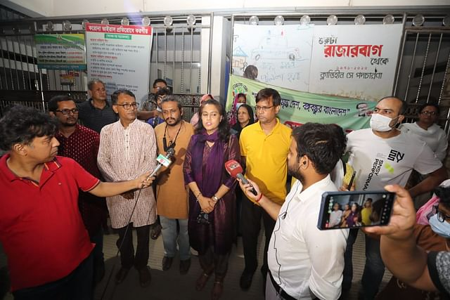

Slide 4
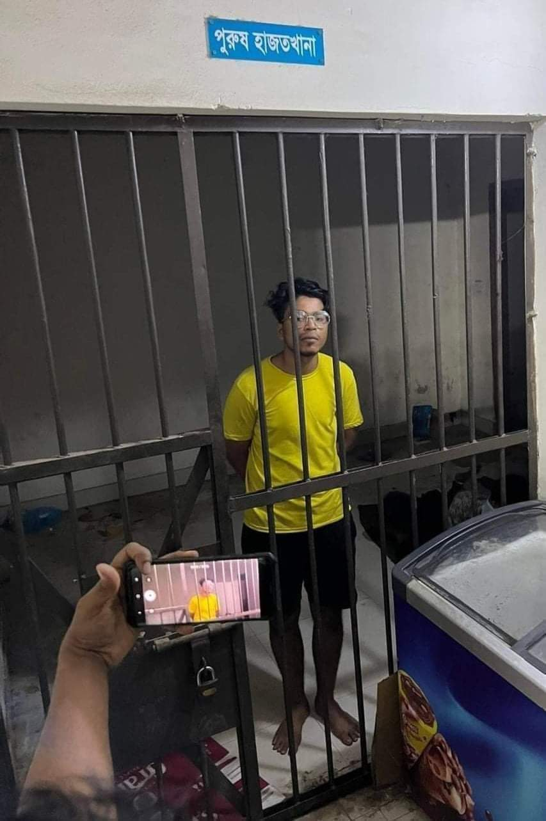
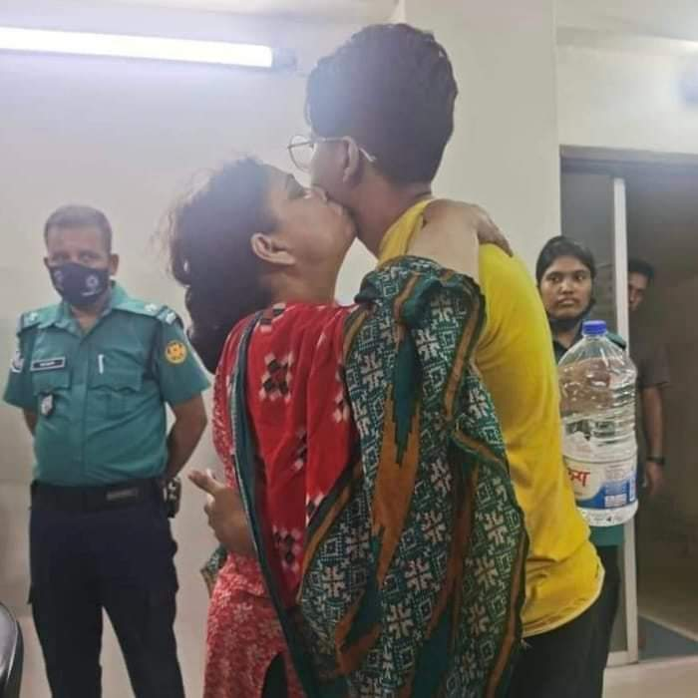

Slide 5


Slide 6
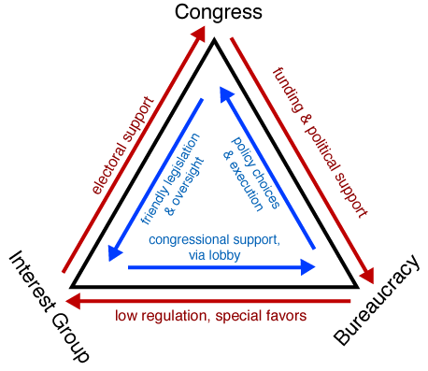
Iron triangle

Slide 7
Who belongs to interest groups?
Every advanced society is pluralistic, with many industrial, cultural, economic, educational, ethnic, and religious groups.
Divergent interests lead almost automatically to group formation.
Usually, interest groups over-represent the better-off and businesses.
Because some groups are rich and well-connected, the democratic playing field is not level.
Elite theorists argue that if group theory really operated, the poor would organize groups to get a bigger piece of the economic pie.
But the poor, who have less education, are slow in forming groups to promote their interests.
Better-off and better-educated people are more likely to participate in politics, and this includes organizing and running interest groups.

Slide 8
Who belongs to interest groups?
In a pluralist democracy, a multiplicity of interest groups push their own claims and viewpoints, creating a balance of opposing interests that, in theory, prevents any one group from dominating the political system. In this optimistic view, government policy is the outcome of competition among many groups, which represent the varied interests of the people.

Slide 9
Types of Interest Groups
Four types of political interest groups:
  (1) associational;
  (2) institutional;
  (3) nonassociational; and
  (4) anomic

Slide 10
Types of Interest Groups
Associational interest group: it is organized specifically to further the political objectives of its members. One example is the British Medical Association (BMA).
Institutional : these groups have been formed to achieve goals other than affecting the political system, but they also pursue political objectives. For example, a large university can be influenced by local and national policies, that is why that university may also try to influence those policies.

Slide 11
Types of Interest Groups
Nonassociational: these groups are fluid aggregates of individuals who are not explicitly associated with a permanent organizational entity but who share some common interest regarding certain issues and become politically active on an issue.
Examples include the women’s rights movement, the civil rights movement, the indigenous peoples movements

Slide 12
Types of Interest Groups
Anomic : these groups are short-lived, spontaneous aggregations of people who share a political concern.
These people participate in a group political action that emerges with little or no planning and then quickly stops after the action is completed.
A riot is the clearest example of an anomic interest group.

Slide 13
Interest Groups Strategies
1. Approaching Lawmakers
The term ‘lobbying’ refers to the efforts of interest group to sway legislation.
Lobbying receives the most attention. The campaign contributions and favors to legislators given by corporations convince many that lobbyists buy Congress.
Indeed, any major interest threatened by new laws spares no expense to make sure the laws are not passed, and they are usually successful.
Big tobacco, which is especially generous to incumbent Republican candidates, routinely blocks or dilutes anti-smoking legislation.
The average lobbying group, however, has little money to give, so most see themselves as providers of information.

Slide 14
Interest Groups Strategies
2. Approaching the Administration
Depending on the issue, the executive branch may be a better interest-group target.
The interest group may not need or want a new law, merely favorable interpretation of existing rules and regulations.
For this, they turn to administrators.
  Antipollution groups, for instance, seek tighter definitions of clean air; industry groups seek looser definitions.
Interest groups concentrate on the department that specializes in their area.
Farm groups deal with the Department of Agriculture, public service companies with the Federal Power Commission, and so forth.
As a rule, each department pays heed to the demands and arguments of groups in its area.

Slide 15
Interest Groups Strategies
3. Approaching the Judiciary
Interest groups may also use the courts, especially in the United States. U.S. judicial system has far more power than most judiciaries, which are merely part of the executive branch.
In countries where rule of law is strong, the courts become an arena of interest group contention, as in Germany, where groups have taken cases on abortion and worker rights before the Federal Constitutional Court.
Every year, U.S. state and federal courts hear cases filed or supported by such interest groups as the American Civil Liberties Union and Sierra Club.
Interest groups use two judicial methods to pursue their goals.
  First, they may initiate suits directly on behalf of a group or class of people whose interests they represent (such suits are commonly referred to as class actions ).
  The second is for the interest group to file a “friend of the court” brief ( amicus curiae ) in support of a person whose cause they share.

Slide 16
Interest Groups Strategies
4. Appeals to the Public
Organized interests often take their case to the public with peaceful—or not so peaceful—appeals.
Even powerful interest groups realize the importance of their public image, and many invest in public relations campaigns to explain how they contribute to the general welfare and why their interests are good for the country.
Some interest groups maintain a low profile by promoting their objectives without advertising themselves.
Such groups may plant news stories that promote their cause and quietly work against the publication of stories detrimental to them.
The Tobacco Institute, for example, discreetly funds research that casts doubt on findings that smoking is bad for your health.

Slide 17
Interest Groups Strategies
5. Demonstrations
Certain organizations, such as the American Cancer Society and the Heart Fund, may get free advertising space and time, but most interest groups do not, and many cannot afford to purchase such publicity.
Such a disadvantaged group may hold demonstrations to publicize its cause.
Ex: Some critics of Wall Street, totally outclassed by the financial and political resources of investment banks, felt that direct protest was their only option. At first the news media paid little attention to Occupy Wall Street in 2011, but the social media brought them supporters, contributors, and eventually news coverage. A placard carried by one Occupier—“We are the 99 percent”—went viral and influenced political debate nationwide.

Slide 18
Interest Groups Strategies
6. Violent Protest
A group that loses faith in conventional political channels may see violent protest as its only alternative.
The United States is no stranger to violent protests, which require a psychological buildup nurtured by poverty, discrimination, frustration, and a sense of personal or social injustice.
An incident may spark pent-up anger, and mob behavior can escalate.
Shootings and arrests of African Americans have sparked riots in U.S. cities.
Defenders of the rioters claim they are simply opposing the violence they suffer daily at the hands of police, all levels of government, and an economy that keeps them underpaid or unemployed.

Slide 19
Elements of Successful Interest Groups
1. Political Culture
Interest groups flourish in pluralistic societies that have traditions of local self-governance and of forming associations.
The more educated are more likely to belong to an interest group.
Not all groups are political, but even nonpolitical groups, by discussion among members, have some political influence.
Members of a bicycle club become involved in politics when they support rails-to-trails bicycle paths.
In societies where many join groups, people have a greater sense of political competence and efficacy.

Slide 20
Elements of Successful Interest Groups
2. The Rise of Big Money
Money is probably the single most important factor in interest group success. With enough money, interests hardly need a group. Money is especially important for elections, and groups help candidates who favor their causes.
Said California political boss Jesse Unruh: “Money is the mother’s milk of politics.”

Slide 21
Elements of Successful Interest Groups
3. The Rise of Single-issue Groups
Perhaps the second-greatest factor in the influence of interest groups (after money) is the intensity of the issue involved.
The right issue can mobilize millions, give the group cohesion and commitment, and boost donations.
Typically, interest groups have several things to say about issues, for their interests encompass several programs and departments.
But to the single-issue groups, only one issue matters, and it matters intensely. Typically, their issues are moral—and therefore hard to compromise—rather than material.
For example, prayer in public school and same sex marriage.

Slide 22
Elements of Successful Interest Groups
4. Size and Membership
Their size and the intensity of their members give groups clout.
Size alone, however, is not necessarily the most important element in interest group strength. Money and intensity often offset size.
The NRA (National Rifle Association) fights gun control laws, mostly successfully. These three — AARP (American Association of Retired Persons), AIPAC (American- Israel Public Affairs Committee), and the NRA—are reckoned as Washington’s most influential lobbies.

Slide 23
8 years old Texas mass shooter
He shot and tried to kill his grand mother first , before killing 19+ children and 3 teachers
​He was severely bullied as a child
He had a stutter problem and lisp , so other children bullied him throughout his life for his speech issues
He started to act violent recently, on one occasion he cut his own skin with a knife for fun
His mother was a drug addict, and he had terrible relationship with his mother
His grand mother wanted to kick out his mother from the house for drugs abuse
He left his mother and moved with his grand mother

Slide 24
Elements of Successful Interest Groups
5. Access
Money, issue, and size may not count for much unless people in government are willing to listen.
The careful cultivation of members of Congress and civil servants over the years makes sure doors are open.
But what happens when groups are shut out and have no access?
Pluralists think this cannot happen in a democracy, but it does.
Black and Native American militants argued that no one was listening to them or taking their demands seriously.
When the wealthy and powerful have a great deal of access, the poor and unorganized may have none.
The consequences sometimes lead to violence.

Slide 25
Suggested readings
Roskin, M. G., Cord, R. L., Medeiros, J. A., & Jones, W. S. (2016). Political Science: An Introduction (14th Edition). Upper Saddle River: Pearson. (Chapter 09)
Roskin, M. G., Cord, R. L., Medeiros, J. A., & Jones, W. S. (2012). Political Science: An Introduction (12th Edition). Upper Saddle River: Pearson. (Chapter 10)
Danziger, J. N., & Smith, C. A. (2016). Understanding the political world: A comparative introduction to political science. Boston :Pearson, pp. 71-74.

Slide 26
Q?

